Slide 1


WHAT IS PHISHING/
WIRE FRAUD?
REPORT ALL PHISHING EMAILS AND FRAUD ATTEMPTS TO THE FBI at IC3.GOV
Notes:
Criminals begin the wire fraud process way before the attempted theft occurs.
Most often, they begin with a common social engineering technique called phishing.
This can take the form of email messages, website forms or phone calls to fraudulently obtain private information.
Through seemingly innocuous communication, criminals trick users into inputting their information or clicking a link that allows hackers to steal login and password information.
Phishing emails might appear to come from a legitimate business or recognized user.
Spear phishing is a more targeted email attack sent to a select number of users, while a whaling attack, also known as Business Email Compromise (BEC), is a more targeted variation of spear phishing aimed at high-profile executives or personnel who manage wire transfers.
The number of wire fraud scams reported by title companies to the Internet Crime Complaint Center (IC3) spiked 480 percent in 2016, according to a warning issued to businesses by the FBI. These are only reported incidents, so the overall number is much larger.

Slide 2
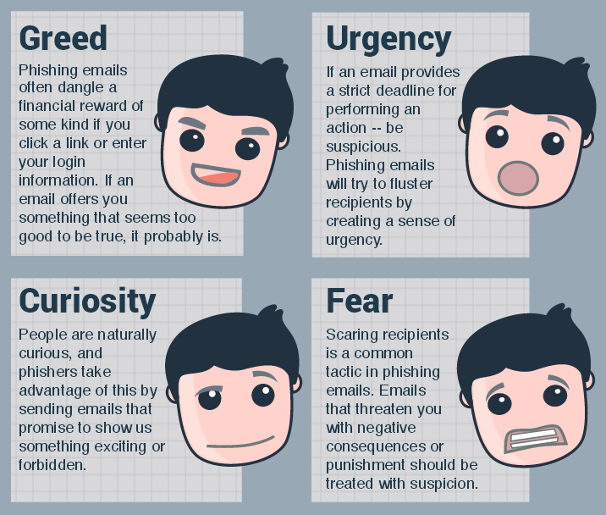
Notes:
How to Spot Phishing Emails: watch out for these four emotions

Slide 3

WHY YOU SHOULD CARE?
$5.3B
Notes:
According to the FBI, fraudsters stole $5.3 billion through wire fraud schemes from October 2013 through December 2016. This is growing exponentially.
The number of wire fraud scams reported by title companies to the Internet Crime Complaint Center (IC3) spiked 480 percent in 2016, according to a warning issued by the FBI.
Recent examples:
Maryland, August 2017: The FBI says fraudsters used fake emails steal the proceeds of the sale of a couple’s home. Amount lost: $411,548
New York, June 2017: A judge trying to sell her apartment received an email she thought was from her real estate lawyer telling her to wire money to an account. Amount lost: $1 million
Washington, D.C., May 2017: Homebuyers lost $1.57 million
Colorado, March 2017: A couple, who lost their life savings while trying to buy their dream retirement home, has filed suit alleging that none of the companies involved in the transaction did enough to protect sensitive financial information.
Amount lost: $272,000
Minneapolis, September 2016: A retired couple hoping to buy a townhouse to be closer to their grandchildren responded to a fake email and sent $205,000 to a fraudulent account. Amount lost: $205,000

Slide 4

WHAT SHOULD YOU DO?
Call,
don’t
email
Be
suspicious
Confirm
it all
Verify
at once
Forward,
don’t
reply
Notes:
Five things you can do
Call, don’t email: Confirm all wiring instructions by phone before transferring funds. Use the phone number from the title company’s website or a business card.
Be suspicious: It’s not common for title companies to change wiring instructions and payment info
Confirm it all: Ask your bank to confirm not just the account number but also the name on the account before sending a wire.
Verify immediately: You should call the title company or real estate agent to validate that the funds were received. Detecting that you sent the money to the wrong account within 24 hours gives you the best chance of recovering your money.
Forward, don’t reply: When responding to an email, hit forward instead of reply and then start typing in the person’s email address. Criminals use email address that are very similar to the real one for a company. By typing in email addresses you will make it easier to discover if a fraudster is after you.

Slide 5

TOP TWO MISTAKES
Use of unsecured email by at least one of the parties in a transaction, i.e, buyer, seller, Realtor and title agency.
No phone calls were ever made to verify or confirm email requests

Slide 6


TO PREVENT WIRE FRAUD

Slide 7

INTERNAL REVIEW
1
Notes:
Make changes to your procedures immediately
Implement review process for wires
Tell Realtors they shouldn’t be sending wire instructions
Implement two-factor authentification

Slide 8

2
Notes:
Create a log of all approved parties’ phone numbers at the start of a transaction.

Slide 9

USE SECURE EMAIL
3
Notes:
Avoid using free, web-based email accounts for business communications.
Private email accounts don’t enforce same level of security as corporate email, and they’re more easily hacked.
Example: Berkshire Hathaway in Washington State requires use of company email or won’t provide E&O

Slide 10
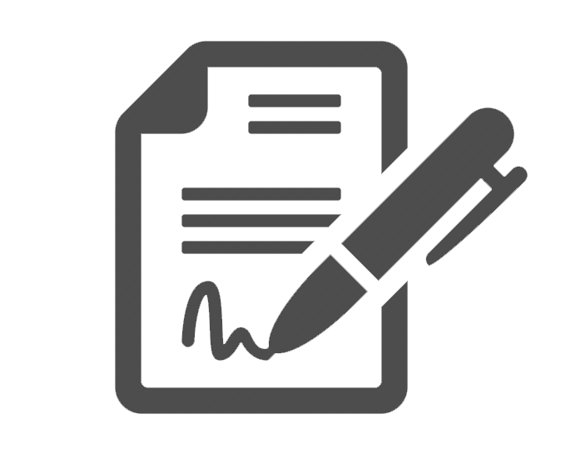
GET AN AGREEMENT
4
Notes:
Prior to closing, execute an agreement with the seller/borrower indicating the method of funds transfer: check or wire.

Slide 11

REFI BORROWERS AT HIGH RISK
5
Notes:
Remember: transactions that result in a large cash payment to a refinance borrower or seller are highly susceptible to attack.

Slide 12
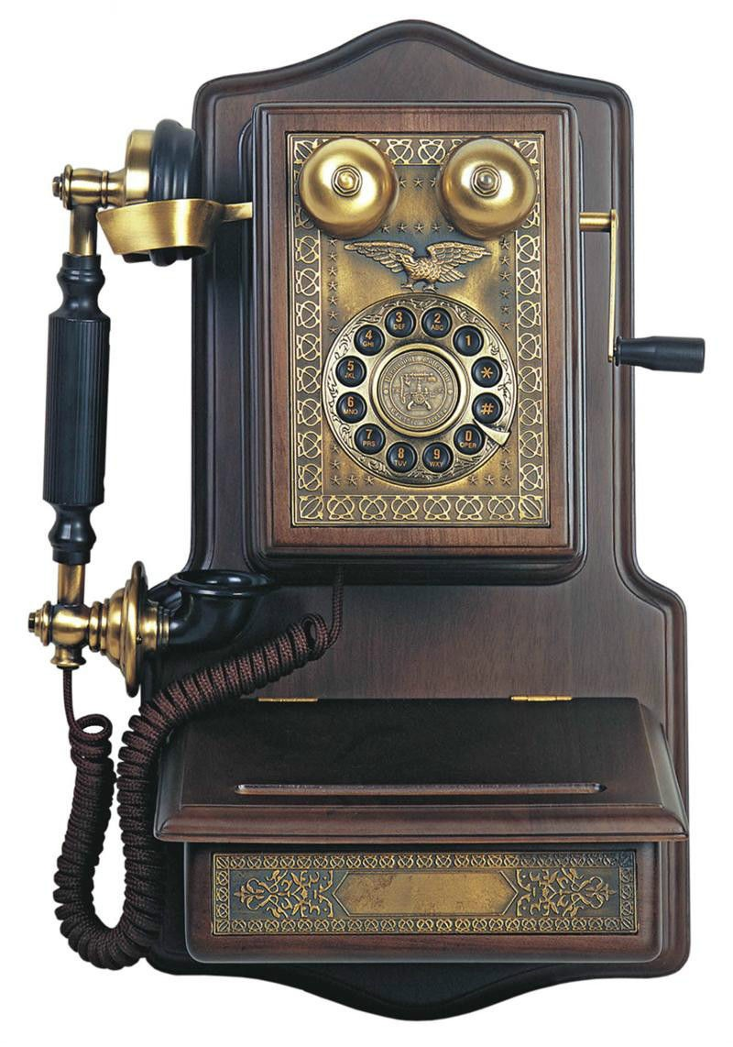
CALL AND CONFIRM
6
Notes:
Question and confirm by phone with approved parties any deviation to the funding agreement ; changes are not common and may indicate fraud.
Confirm wiring instructions by phone with approved parties prior to sending.
Confirm receipt of wired funds by phone with the intended recipient.

Slide 13

CYBER HYGIENE
7
Notes:
Practice good cyber hygiene: keep antivirus software up-to-date, don’t click suspicious links, and use strong passwords.
Watch out for phishing emails with embedded links, even when they appear to come from a trusted source.

Slide 14

8
Notes:
Slow down and stay in control; a slow, confirmed closing is still acceptable.

Slide 15

9
REPORT ALL PHISHING EMAILS AND FRAUD ATTEMPTS TO THE FBI at IC3.GOV
Notes:
If you suspect fraud, act immediately; contact the FBI, your bank and appropriate authorities.

Slide 16
REAL LIFE EXAMPLE
10
From: Christine Windle [mailto:cwindle@alphacoelectric.com]
Sent: Monday, March 27, 2017 3:18 PM
To: undisclosed-recipients:
Subject: 15805 Kensington Palace Ct
See attached contract for the reference property, my client is a cash buyer and want to close early. I look forward to working with you.
--
Christine Windle
Dulles Area Association of REALTORS®
21720 Red Rum Drive, #177
Ashburn, VA 20147
Phone: (703) 777-2468
Fax: (703) 771-9787
E-mail: cwindle@dullesarea.com

Slide 17
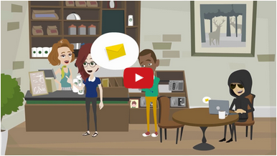
ALTA RESOURCES
www.alta.org/wirefraud
Notes:
To help raise awareness about wire fraud, ALTA created a 2-minute video that provides four tips on how consumers can protect their money and offers advice on what to do if they have been targeted by a scam.

Slide 18
ALTA.ORG/HAPPYCLOSINGS
Free PDF download
Purchase branded graphic with company information and logo
Notes:
In addition to the video, ALTA has developed an infographic to help raise awareness. ALTA has created a portal where real estate agents can brand the infographic with their own information at alta.org/happyclosings.
You can link to these resources from their website, include in email or share on social media.

Slide 19

“ONLY YOU CAN PREVENT WIRE FRAUD”
RESOURCES AVAILABLE AT ALTA.ORG/WIREFRAUD
Notes:
While Wire Fraud is on the rise, so must your awareness rise of possible fraud occurring on every transaction you handle. The Cyber Criminal will find your weakest link and exploit it. It’s up to you to keep your procedures strong and tight! Smokey the Bear has a saying: “ONLY YOU CAN PREVENT FOREST FIRES”
We say: Only You can Prevent Wire Fraud

