Slide 1


COMPLIANCE WEBINAR SERIES
BROUGHT TO YOU BY OLD REPUBLIC TITLE INSURANCE CO.
Understanding Consumer Privacy Rights
Elizabeth Reilly | Senior Privacy Counsel | Fidelity National Financial
Steve Tjaden | Chief Privacy Officer | Old Republic National Title Insurance Co.
Elizabeth Blosser | Senior Director of Government Affairs | ALTA
Notes:
Nicole – Intro
E –
- Thanks so much for having us today.
- Personal Intro
- I work with our state land title associations and our state legislative priorities. I also oversee our strategic priorities of digital closings and data privacy.

Slide 2
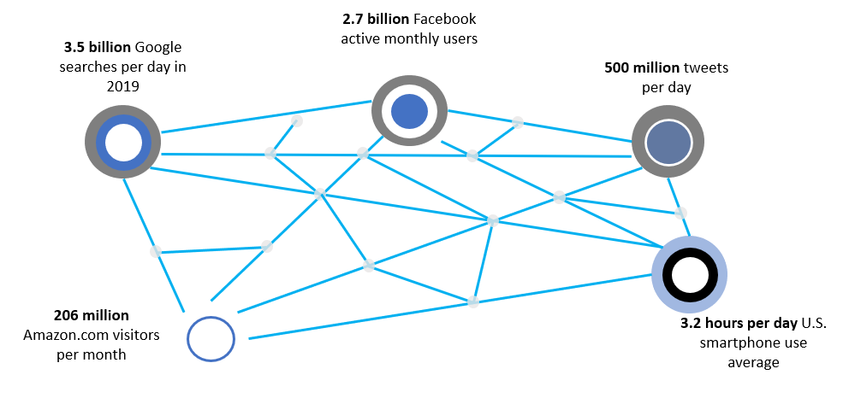
Privacy in the Data Economy

Slide 3
Privacy in the Data Economy
Industries subject to regulation

Slide 4
Privacy Defined: Fundamental Shift & Core Regulatory Concepts

Slide 5
Privacy Defined: Privacy vs. Security
Key differences emerging:

Slide 6
Privacy Timeline

Slide 7
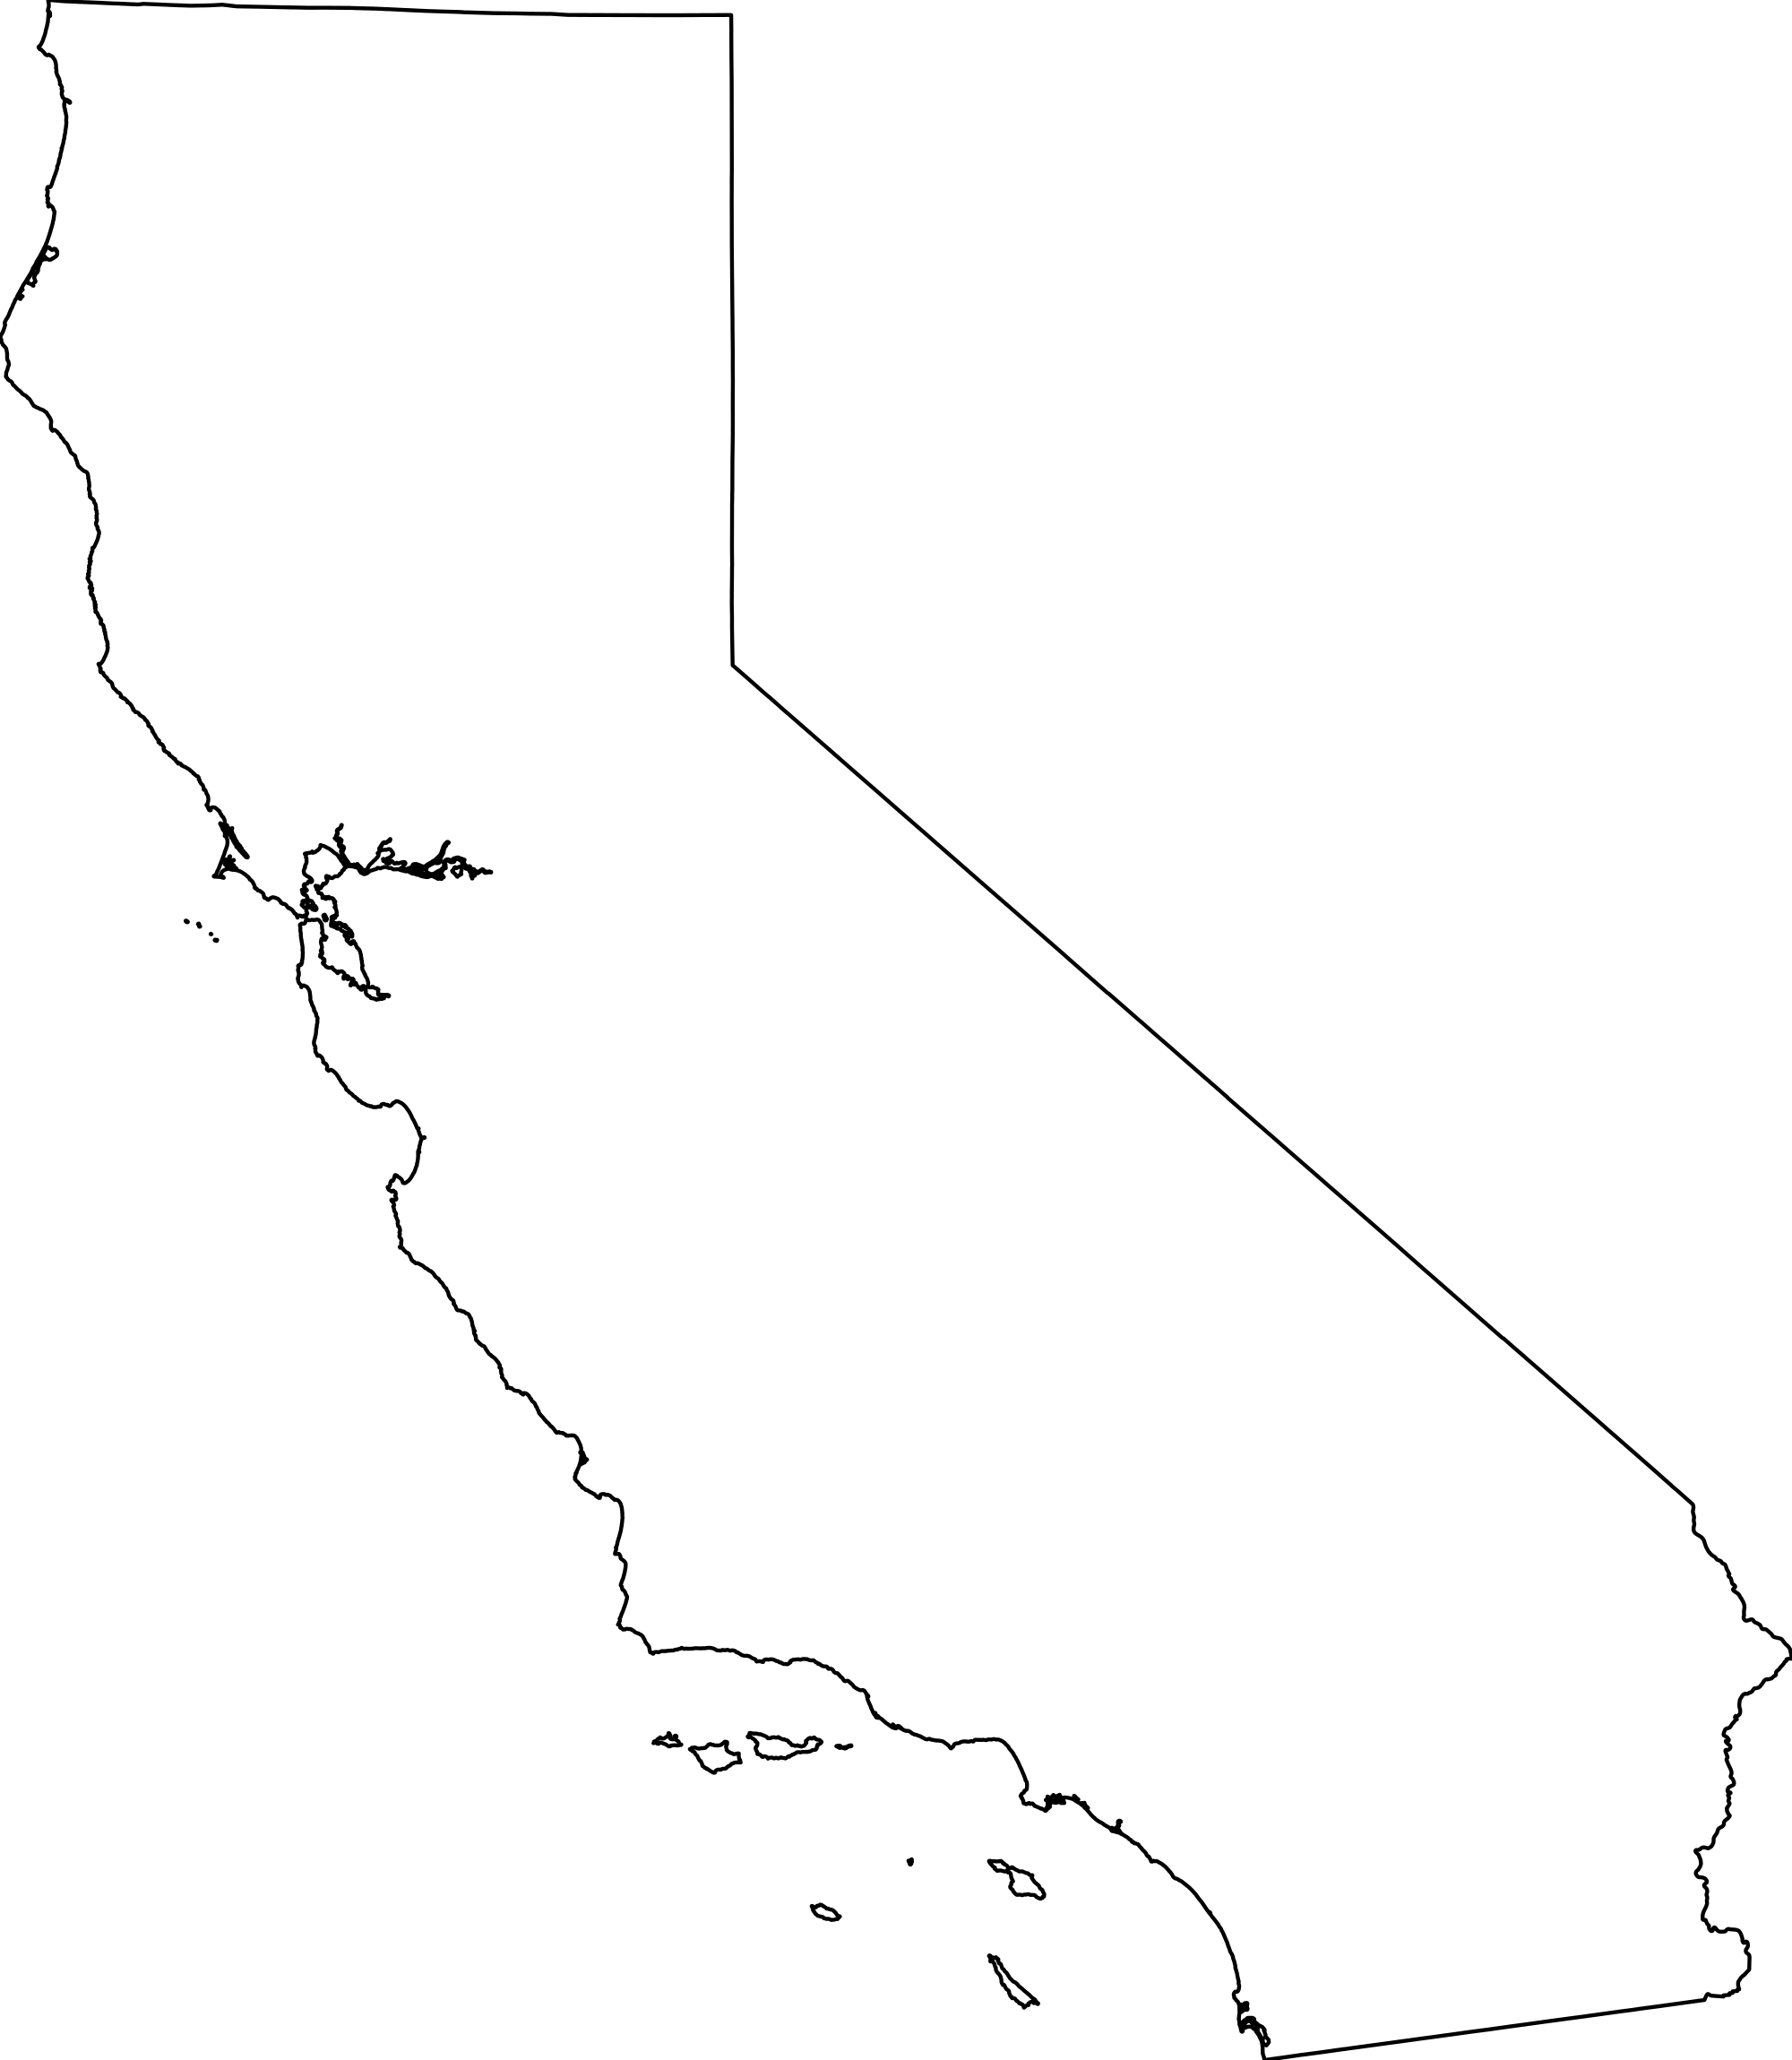
California Consumer Privacy Act
Sweeping first-of-its-kind privacy law, which took effect January 1, 2020
Covers for-profit entities doing business in CA who collect personal information of a CA resident and control what happens to the information AND
Earn $25 million in annual gross revenue annually
Buy, receive, sell or share for commercial purposes 50,000 consumer records per year OR
Earn at least 50% of annual revenue “selling” personal information

Slide 8
California Consumer Privacy Act
Creates a series of rights for California residents:
Right to Know – categories and specific pieces of personal information held
Right to Delete – all personal information held about the consumer
Right to Opt-Out of Sale – “sale” is any exchange of personal information for value
Right to Non-Discrimination – cannot charge a different price for exercising rights under the CCPA
Right to litigate/damages – CA consumer whose information is involved in data breach can sue for statutory damages

Slide 9
California Consumer Privacy Act
Personal information* includes:
Identifiers (name, address, online identifier, email address, account name, SSN, driver’s license number, passport number)
Education, medical, or health insurance information
Financial information
Personal property records, products or services purchased or considered
Internet activity, internet browsing history, and interactions with a website
Professional or employment-related information
Geolocation data
Inferences drawn from the consumer’s information for creating a consumer profile
*Excludes public record data, employee data and B2B/CRM data (AB 1281 Update)

Slide 10
California Consumer Privacy Act
Service Provider vs. Third Party Contracts
“Service provider” processes information on behalf of a business and to which the business discloses a consumer's personal information for a business purpose pursuant to a written contract, provided that the contract prohibits the entity receiving the information from retaining, using, or disclosing the personal information for any purpose other than for the specific purpose of performing the services specified in the contract for the business, or as otherwise permitted by this title, including retaining, using, or disclosing the personal information for a commercial purpose other than providing the services specified in the contract with the business.”

Slide 11
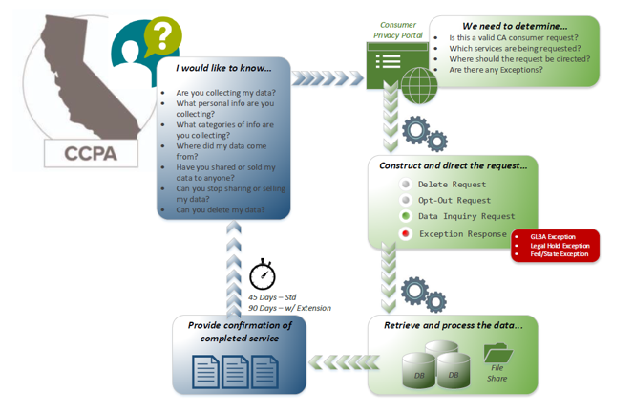
California Consumer Privacy Act

Slide 12
California Consumer Privacy Act- Litigation
California consumers can bring civil suits for statutory damages after a data breach:
Can seek statutory damages of between $100 and $750 “per consumer per incident or actual damages, whichever is greater.”
No need to prove actual damages, a big shift for data breach litigation.
Data breach involves narrower definition of “personal information” - Name + SSN, DL Number, or CA ID card number; account, credit card, or debit card number, with password or code giving access to financial account; or medical or health insurance info.

Slide 13
California Privacy Rights Act
California voters passed a ballot imitative in November to replace CCPA with the CPRA, which the legislature can not substantial change:
Effective January 1, 2023, but applies to any information collected on or after January 1, 2022
Removes 30-day right to cure
Reduces applicability to small business by increasing number of consumers from 50k to 100k
Expanded and modified “rights” and new category of “sensitive” information
Creates new regulatory enforcement authority
Disclosure of data retention time frame
Retains GLBA exemption
Extends employee and B2B exemptions to January 1, 2023

Slide 14
Preparing for CCPA/CPRA and Similar Regulations
Determine law’s applicability
Am I a covered business?
Do I possess personal information covered by the law?
Am I subject to partial or complete exemptions?
Data mapping
What personal information do I collect?
Where it is stored? Is it accessible if I have to modify or delete?
For what purpose do I collect it? Do I use it for any other purpose?
Do I share the information with third parties or services providers?

Slide 15
Preparing for CCPA/CPRA and Similar Regulations
Update disclosures
Notice at collection
Right to opt-out of the sale of personal information (Do Not Sell)
Regarding incentives
Privacy policy (listing privacy rights and how to exercise them)
Develop operational compliance program
Website and app notices
Enable “do not sell” capabilities if selling data
Develop consumer rights response process
Set up multiple contact points for consumer requests
Require training for all employees handling consumer requests

Slide 16
Preparing for CCPA/CPRA and Similar Regulations
Security practices and procedures
Benchmark information security program against industry standards
Create and test incident response plan
Review third party contracts
Do service provider contracts meet regulatory requirements?
Do they restrict information use and prohibit sale of personal information?
Do contracts require cooperation with consumer requests and compliance obligations?

Slide 17
Redaction: Pending Legislation and Best Practices

Slide 18
Redaction and Record Shielding
The title industry recognizes limiting access to certain personal information in government records can help protect the safety of at-risk groups.
The title industry needs to be a leader in identifying thoughtful solutions that protect at-risk parties, without restricting the ability to buy, sell or refinance real estate.
The industry needs to prepare to accommodate process changes, knowing we can’t continue with the status quo.

Slide 19
Identifying Effective Solutions
The best way to shield sensitive information is to limit who has access to the protected data, without removing or altering vital public records.
Effective state programs have taken one of two approaches:
In Arizona, an eligible person files an affidavit with the court to prohibit the general public from accessing personal information. If approved by the court, an order is issued directing the clerk to prohibit public access to the information. The prohibition on public access expires after a period of time, generally 4-6 years. Access for real estate/title professionals is available.
In Minnesota, an eligible person files an application with a state agency, usually the Attorney General or Secretary of State, to certify eligibility for the program. Once certified, a participant may file a notice to prohibit public access to government records containing personal information. Access for real estate/title professionals is available.

Slide 20
Creating Best Practices for Implementation
Permissioned access should be available to:
  Someone with a signed release from the protected individual or court order;
  Licensed professionals with existing consumer privacy/confidentiality requirements (attorneys, title professionals, assessors, etc.);
  Licensed entities with a signed confidentiality agreement with a government entity.
State-wide uniform standards and processes must be followed to ensure all records pertaining to an individual are properly shielded.
The general index must not shield or redact the full combination of name and address. Records must be discoverable within the public records index, which should include a flag indicating that the document has been shielded.
Shielding requests should be time limited to minimize long-term impact on the real estate conveyancing system and ensure the continued accuracy of the public records. A renewal request can be submitted every four to six years.
A process for record restoration must exist to facilitate real estate transactions and transfers, or administration of a will.
Authorized access to shielded government records should be available electronically, as well as in-person, to allow for social distancing measures and, absent a public health necessity, to accommodate access for non-local authorized parties.
Government entities and third parties should maintain robust records to track and log access of shielded records.

Slide 21
State and Federal Legislative Activity
Congressional Activity: Daniel’s Law, the Judicial Security and Privacy Act of 2020 (S. 4711 and H.R. 8591)
Increasing State Activity
  New Jersey
  Florida
  Ohio

Slide 22


Slide 23
Thank You
Elizabeth Reilly – elizabeth.reilly@fnf.com
Steve Tjaden – stjaden@ortc.com
Elizabeth Blosser – ebloser@alta.org

