Slide 1
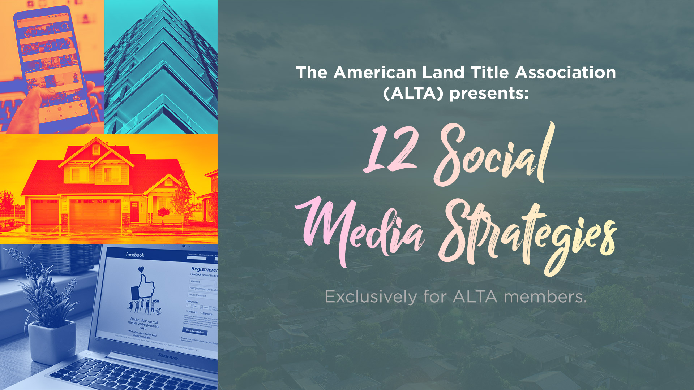


Slide 2









Video use, company thought leadership and customer promotions can elevate your Facebook page and win new customers.
Target Realtors with content marketing, thought leadership and a reminder of your core services can build a hefty LinkedIn following.
Twitter can be powerful in your local community. Target homebuyers and Realtors with the right hashtags and engaging conversations.
Hashtags are a currency on Instagram. Learn how to find the right hashtags and use Stories to your advantage.
Crafting an engaging Google Ad message is the most important part of any successful ad campaign.
Ensuring your company has adopted a review culture will build your Yelp following and get more reviews than ever before.

Slide 3



Facebook Strategy #1
Digital video marketing is a $135 billion industry in the U.S. alone. It’s estimated that on average each American business will spend $20,000 on video advertising in 2018.
If your company hasn’t considered a video strategy, Facebook is a great place to start. Consider all the networking events you attend (or host) each year. Designate someone on your team to use Facebook Live during the event to briefly show your followers what they are missing.
Facebook Live videos are automatically recorded and posted on your page. And because it’s live, you don’t have to worry about editing time, approvals, etc.
If going live at a networking event isn’t for you, consider going live from the county recorder’s office to show a behind the scenes look at the title process. You could also go live when one of your customers drops by the office to have them explain their responsibilities in the real estate transaction.
The possibilities are endless for video. Go Live and see what works best for your title company.

Slide 4

Facebook Strategy #2
Thought leadership is an important part of any Facebook strategy. It’s all about showing your benefits rather than telling someone about them. Make sure your posts aren’t only listing your service, highlighting your achievements or mentioning how long you’ve been in business. Instead, show thought leadership by explaining why you’ve been in business for so long. Tell a story about how your services help your customers. Instead of splashing a post about your new website or team member, provide a story on why you hired them or what it took to build your new site.
Stay in your lane and focus on what you know best. If you’re known for innovation, talk about the future of the industry. If you’re known as the most knowledgeable source on real estate, talk about the most difficult parcels in the county.
Stick to what you know and tell a story about why you’re
such an expert.

Slide 5

Facebook Strategy #3
Realtors do a tremendous job at “customer promotion” and appreciation. They are quick to thank their real estate partners and the buyer or seller for working for them and how much it means to them.
Sure, your customer has traditionally been the Realtor and lender but that doesn’t mean you can’t publicly appreciate their business. Start a campaign that encourages your Realtor customers to include a “Protected by” statement in their closing post with the buyer or seller. Imagine your referral opportunities if your Realtor started promoting “Protected by ABC Title Company” in their posts.

Slide 6


LinkedIn Strategy #1
Thought leadership on LinkedIn allows you to create posts that tell a story about topics you’re most passionate about. Perhaps you’ve outgrown your current office space and are moving to a new, renovated location. Instead of posting the “news” of your new office, try talking about what led you to that decision. What steps did you take in the process? This is information your audience will love and elevate your content with your followers.
Another idea for showing thought leadership would be to highlight the top three things you learned about _______ this year. Choose any topic you’re most passionate about and highlight the biggest changes, challenges or opportunities for the issue/product/service/business in the next year. It’s a great way to highlight your leadership on the issue without listing your accomplishments or activities.

Slide 7

LinkedIn Strategy #2
Content marketing positions your ideas as educational topics for your customers. Old-school marketing, even social media post guidelines as of five years ago, would tell you to promote your product or service first and explain its benefits in broad terms.
Education marketing helps you introduce a new topic to your audience and have them interact with you beyond your average “sales call.” Some of the best content marketing tactics include social media tips, ideas for blog posts, market research and highlighting new technology.
Innovation is a buzzword in every industry right now. However, if you can make the connection between why a new technology is so important and how it can increase business for your customers you’ve got a great content marketing opportunity.

Slide 8

LinkedIn Strategy #3
As small businesses, we sometimes take for granted that our customers will remember all the products and services we offer. Everyone is focused on their own world. Even if you’ve maintained a customer for 20 years, you can be sure that you have one or two services they don’t remember.
Use your LinkedIn content to discuss your core products and services. Remind customers of some of the biggest pieces of your business and why you’re such an expert in that area. Use your content to create polls and conversations that engage your audience about topics that relate to your services. You’d be surprised how much business you can gain from your current customer base.

Slide 9


Twitter Hashtag Strategy #1
Twitter can be a powerful connector in your local community. You can use #hashtags and other phrases to search topics or events that your market is most interested in.
Twitter is a great place to host a local real estate chat. Develop a single, non-branded hashtag, and ask your clients to promote the chat with their customers. You can have conversations about new real estate developments, commercial real estate, public projects and more. Be sure to invite your local elected officials to participate too. It’s great exposure for your company without having to directly market to these individuals.

Slide 10

Twitter Hashtag Strategy #2
Look at the profiles of your local Realtors. Follow their accounts and look at the hashtags they use. Once you understand which hashtags are most popular you can create content for those hashtags and reach a broader group of people in your community. (P.S. Don’t forget the For Sale By Owner market in your area too)
Twitter can also be a great referral source as well. As you’re watching the conversations your Realtors and lenders have on Twitter, jump in and remind them about the services you offer and how much you’ve enjoyed working with them in past. When you want to reach out to a new contact or share good news with a client, make sure to mention their Twitter name (called a “handle”) to give them some public praise. For example, ALTA’s Twitter handle is @ALTAonline.

Slide 11


Instagram Strategy #1
#Hashtags are like an online filing cabinet. If you search “#love” you’d see posts from around the world mentioning this word. BTW, #love is still the most used hashtag across the internet. Use the “search” function on Instagram to find hashtags used most often in your market. Try using “#DCrealestate” or “#AustinHomes” to see what related hashtags pop up in your area. Look at the kinds of posts and content others are creating with those hashtags. You can follow those individuals and create posts that interact with their content or engage those accounts. This is a great way to build followers and engagement at the same time.

Slide 12

Instagram Strategy #2
Instagram Stories are a great way to interact with your followers and test new content. Instagram Stories can be shared widely with everyone that follows you or you can send them to individual followers.
You can use Instagram Stories to highlight new team members, showcase a new service or tool for your customers or even interview other real estate professionals in your market.
Whatever you choose to do, make sure you tag the location on the Story so that others looking at the location can see your post and interact with you in the future.

Slide 13


Google Ad Strategy #1
You’ve used Google before to find a restaurant in a new city or look up college basketball rankings. And in those searches, you’ve probably seen the ads that appear above your search results. You can get started with Google Ads for less than $25 a month. However, the most important part of the campaign is crafting the ad itself.
You only get a few words to catch someone’s attention and make them click on your ad. Your headline of the ad should be engaging and use the various keywords your customers are searching for. The sub-headline should mention your company and have an action step. You need to be clear and concise. You can use the description to describe your company or service with a little more detail.
Develop at least three ads for each campaign to test your phrases and calls to action in a variety of formats. The more you test your content, the more successful your ads will be.

Slide 14


Yelp Strategy #1
Many title companies struggle with the best way to build up their reviews on Yelp. The best way to receive a steady stream of reviews is to build that culture into your company.
We’re asked for reviews from just about every other business we encounter, from our mechanics to our florists. It’s not out of the ordinary to ask your customers for reviews as well. Work it into your post-closing routine to ask your Realtors and lenders for a review on Yelp. Every time someone on your staff hears “you guys do a great job” or “this closing was great as always” your staff should be trained to say, “thank you so much, we’d love it if you reviewed us on Yelp.” Work it into your next staff meeting and see how quickly your reviews stack up.

Slide 15




