Slide 1


Slide 2

Notes:
WHAT IS THE GOAL OF HOP? WHY WAS IT CREATED?

Slide 3
IT’S OUR RESPONSIBILITY TO EDUCATE ALL STAKEHOLDERS
Notes:
As the title insurance industry leaders, it is our responsibility to educate the industry and all stakeholders in the home-buying process.
EXPLAIN RESEARCH AND FOCUS GROUPS.

Slide 4


MEDIA-SATURATED WORLD
4
Notes:
We live in a complex, media-saturated world, where every day we face new competition, new regulations, and increasing technological threats of disruption. Now, more than ever, we need to take control of the message and empower our teams, colleagues and fellow industry experts on the importance of owner’s title insurance in order to educate homebuyers. The reason we assembled this group of experts is that we believe you are the leaders who will carry the message and teach others how to communicate the importance of owner’s title insurance. We will be a unified front and trusted experts for our fellow partners (Realtors®, attorneys, builders and lenders).

Slide 5

Notes:
THE QUESTION IS WHY SHOULD I MARKET TO CONSUMERS HERE? YES, THE INDUSTRY IS DIFFERENT EVERYWHERE. HOWEVER, WE’RE UNDER PRESSURE FROM ALL SIDES TO INCREASE UNDERSTANDING OF OUR INDUSTRY. THE BEST WAY TO ACCOMPLISH THIS IS WATER YOUR OWN GRASS.

Slide 6


PROTECT
YOUR
PROPERTY
RIGHTS
6
Notes:
It starts with acknowledging this: we are not in the title, insurance, protection, closing, settlement and underwriting business; we are in the peace-of-mind business. We offer homebuyers the knowledge, confidence, security and assurance that their property rights are protected. By viewing our businesses through a B2C lens, we are able to connect emotionally, build relationships, get in front of the homebuyers at an earlier point in the transaction, and ensure that we are the carriers of OUR message (not the realtors or lenders message).

Slide 7

7
Notes:
It starts with acknowledging this: we are not in the title, insurance, protection, closing, settlement and underwriting business; we are in the peace-of-mind business. We offer homebuyers the knowledge, confidence, security and assurance that their property rights are protected. By viewing our businesses through a B2C lens, we are able to connect emotionally, build relationships, get in front of the homebuyers at an earlier point in the transaction, and ensure that we are the carriers of OUR message (not the realtors or lenders message).

Slide 8



Slide 9




PERSONALITY
TRUSTWORTHY
PRACTICAL
RESPONSIBLE
Notes:
Therefore, the HOP personality represents that…
We are trustworthy: No one knows more about title insurance than we do.
We are practical: We help homebuyers buy with ease and more confidence.
We are responsible: It just makes sense to protect your biggest investment.

Slide 10
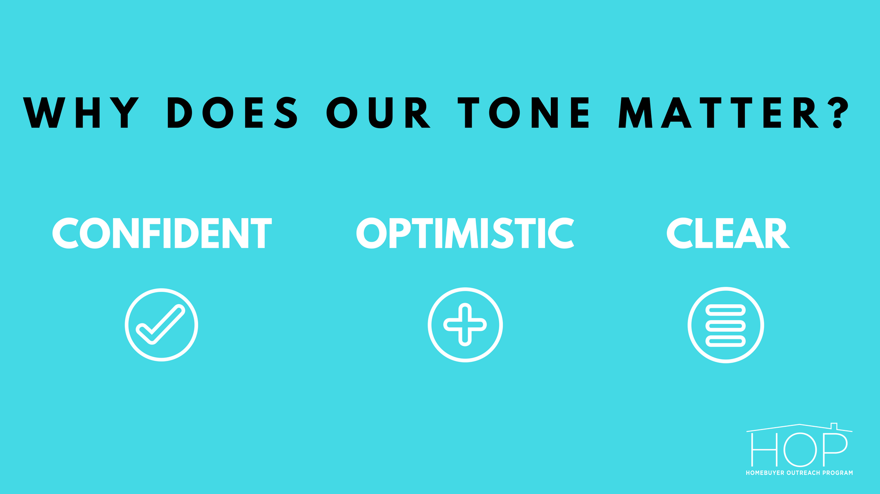



TONE
CONFIDENT
OPTIMISTIC
CLEAR
Notes:
Our tone represents “how we express ourselves” in this campaign, because we are actively helping American homebuyers make better decisions about protecting their property…
Our attitude is confident. As the experts, we know best how to help homebuyers.
Our attitude is optimistic. Title insurance is important, relevant and valuable for all homebuyers.
Our attitude is clear. We don’t use jargon; we focus on why insurance is valuable (not “what it is”).

Slide 11


Slide 12

Notes:
In the next few slides we will explore the three homebuyer message themes, beginning with the strongest message—Peace of Mind—followed by Reduce Your Risk and The Smart Option.

Slide 13
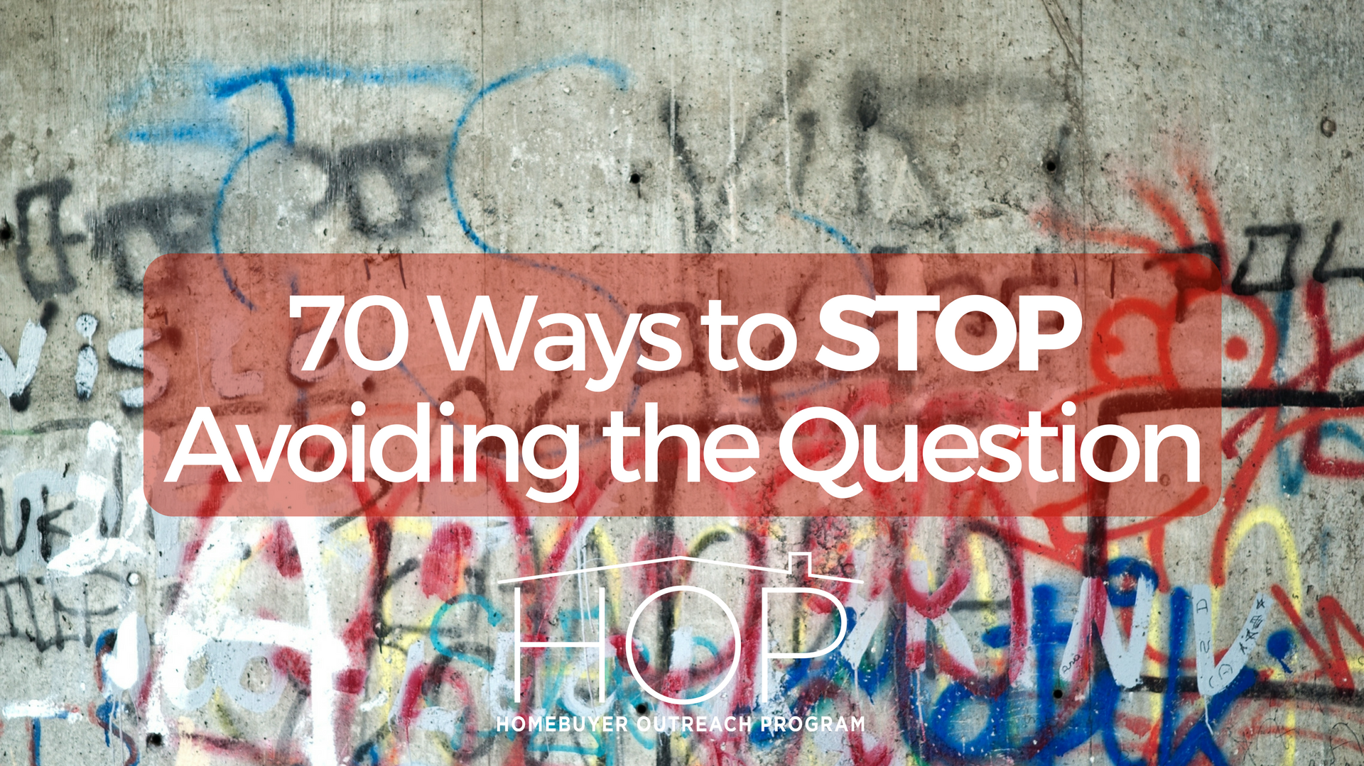
ABOUT THE HOMEBUYER GUIDE
13
Notes:
The Homebuyer Guide includes:
Blogs
Marketing one-pagers for homebuyers and Realtors®
PowerPoint presentations for Realtors® and closing agents
Rack cards for homebuyers and Realtors®

Slide 14


Slide 15


Slide 17


Slide 18


Slide 19

19

Slide 20

20

Slide 21

21

Slide 22


Slide 23


Slide 24


Slide 25



Notes:
Print the customized tools by visiting ALTAprints.com
NOTE: ALTA to distribute ALTAprints.com scratch off lottery tickets

Slide 26


Slide 27


Slide 28


